Slide 1
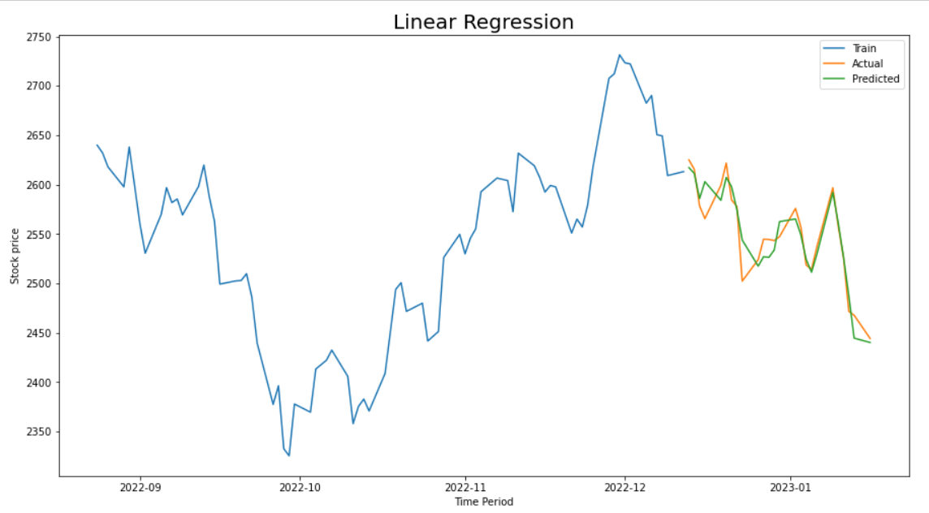
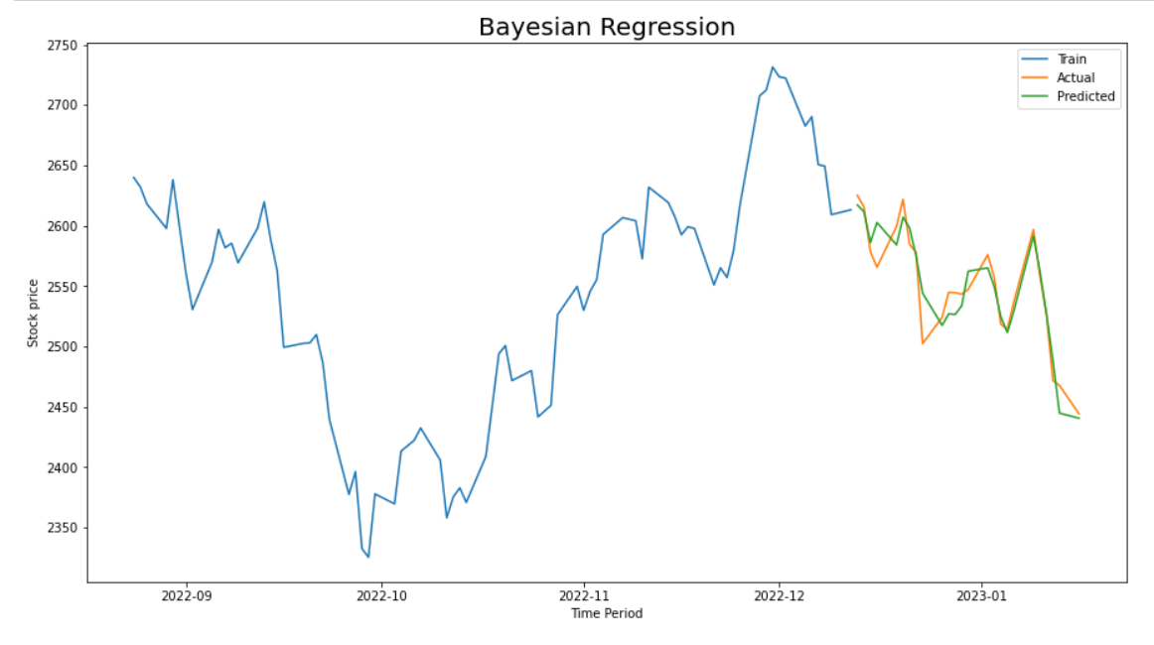
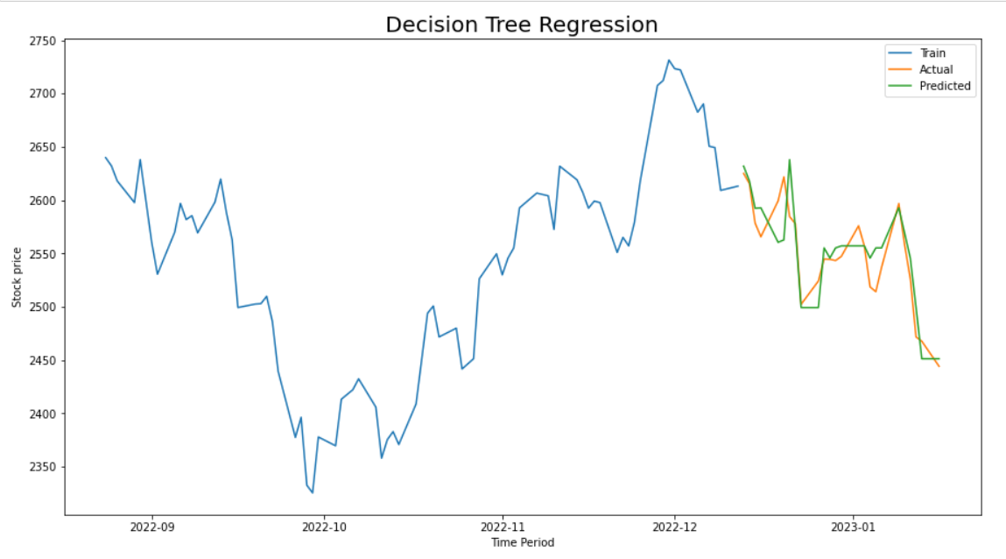

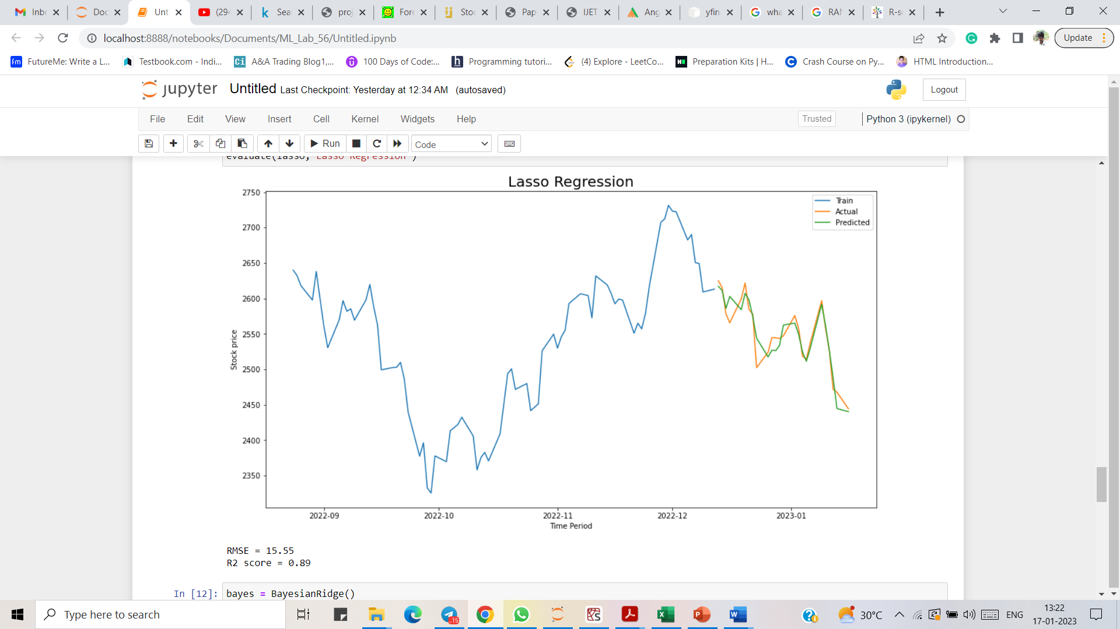
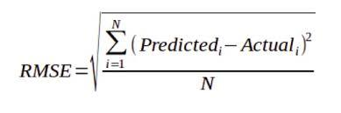
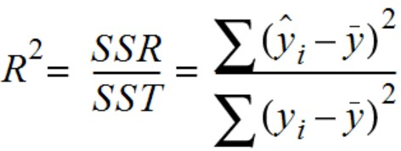
Comparative analysis of various regression models on stock market price prediction
Lakshman Raj G (2021179023) – MCA (SS) 3rd Semester
Department of Information Science and Technology, College of Engineering, Guindy, Anna University.
ABSTRACT
Stock market plays a very important role in fast economic growth of the developing country like India. Several techniques and models have been proposed and devised to predict the stock price prediction in the past. This project aims to perform a comparative analysis on various regression models in predicting the price of a stock.
    Motivation
The successful prediction of a stock's future price will maximize investor’s gains. Stock market prediction is a major challenge owing to non-stationary, blaring, and chaotic data, and thus, the prediction becomes challenging among the investors to invest the money for making profits.
    Limitations
Stock market prices are so volatile.
Stock market prices depend on various factors both technical and fundamental factors.
    Objectives
To apply various regression models on the historical data of stock prices.
To predict the future price of stock using regression models.
To compare the accuracy of each model in predicting the stock prices.
RESULTS AND DISCUSSION
METHODOLOGY
    Collecting dataset
The NSE website gives the list of Nifty 50 stocks.
The yfinance module in python offers a way to download historical market data from Yahoo finance.
    Preprocessing of data
The dataset contains features like Open, High, Low, Close, Adjusted Close and Volume of individual stocks.
The Open, High, Low price of the stock act as the independent variable(X) and the Closing price of the stock is the dependent variable(y).
    Splitting dataset into training set and test set
The 75% of the dataset is taken for training the model
The rest of the 25% of data is kept for testing the model.
    Building model
The regression models that are employed are Multi-Linear Regression, Decision tree Regression, Lasso Regression, Bayesian Regression and Polynomial Regression
.
    Accuracy metrics of models
    Training and testing the model
The various regression models are trained using the training dataset.
The models are then tested with the test dataset to predict the Stock Closing price.
MODEL | RMSE | R²
LINEAR REGRESSION | 15.52 | 0.89
DECISION TREE REGRESSION | 24.13 | 0.73
LASSO REGRESSION | 15.55 | 0.89
BAYESIAN REGRESSION | 15.54 | 0.89
POLYNOMIAL REGRESSION | 13.18 | 0.92
    Calculating accuracy of model
The parameters Root Mean Square Error (RMSE) and Coefficient of Determination (R2) are used to define the accuracy of the model.
CONCLUSIONS
From the plotted graph, the variation in predicted and actual stock prices can be interpreted easily for each of the regression models.
On comparing the accuracy metrics of models, it has been found that Polynomial Regression model with degree of 2 gives better accuracy with lesser RMSE value of 13.18 and higher R2 value of 0.92.
On the other hand, Decision Tree Regression model has lesser accuracy with higher RMSE value of 24.13 and lesser R2 value of 0.73.
The above-mentioned conclusions are arrived only for the historical data of Reliance Industries Ltd shares.

